Slide 1
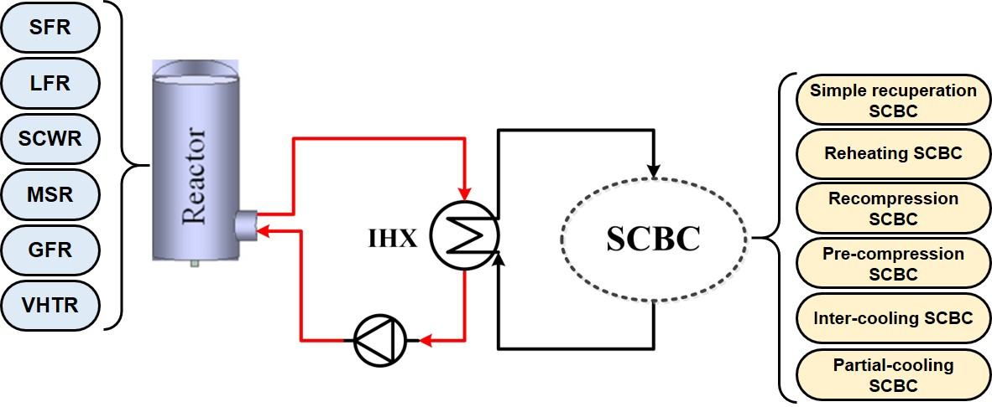
Master Thesis
Title: Thermodynamic analysis of the Generation-IV nuclear power system based on different supercritical CO₂ Brayton cycle layouts
Begin: Immediately
Type of the work: Simulation and Programing
Proposal date: 05.31.2022
Domain: Thermodynamic and system design
Generation-IV reactors are currently being actively developed due to their high reactor outlet temperatures (ROTs) and inherent safety. The supercritical CO₂ Brayton cycle (SCBC) is a very promising thermodynamic cycle to be integrated with a Generation-IV reactor for achieving high power generation efficiency. Given that different types of Generation-IV reactors have different ROTs and the SCBC also has various cycle layouts, it will be very interesting to select the suitable SCBC layout for different types of Generation-IV reactors.
Graphical abstract of the master thesis
Task/Plan: This master thesis is preliminarily planned to consist of the following five sections: (1) the Introduction section, in which the research background and literature review of this topic will be presented; (2) the System conceptual design section, in which several typical system conceptual designs will be presented; (3) the Mathematical modeling section, in which the mathematical models of the system will be established from the perspective of thermodynamics and economics; (4) the Parametric analysis and optimization section, in which the effects of some key operating parameters on the system performance will be analyzed, and based on the obtained results, the parametric optimization will be performed; (5) the Summary and conclusions section, in which the important research results will be summarized and the main conclusions obtained will be presented.
Prerequisites: Knowledge of the thermodynamics;
Interest in thermodynamic system design and analysis.
Contact: M.Sc. Qi Wang, Room: 0430, Email: qi.wang@tum.de
Technische Universität München
Prof. Dr. Rafael Macián Juan ∙ School of Engineering and Design ∙ Dept. of Energy and Process Engineering ∙ Lehrstuhl für Nukleartechnik
Boltzmannstrasse 15 ∙ 85748 Garching ∙ Deutschland ∙ Tel: + 49.89.289.15620 ∙ Fax: +49.89.289.15622
info.nte@ed.tum.de ∙ www.epe.ed.tum.de/ntech

